Slide 1


Deep Learning based Medical Sequence Auto-Analyzer
Sanghyung Jin, MS ¹, Yourim Lee, BS ¹, Rae Woong Park, MD, PhD^{1,2}
¹Department of Biomedical Informatics, Ajou University School of Medicine, Suwon, South Korea;
²Department of Biomedical Sciences, Ajou University Graduate School of Medicine, Suwon, South Korea

Slide 2
What is it
Brief Info.
An automatic medical sequence data analyzing tool to predict high-risk patients by using deep learning method from OHDSI-CDM databases.
Main features
OMOP-CDM eco.
Reformatting transactional data (DB) to sequential data (Tensor)
Embedding methods
Building multiple & flexible deep learning models easily.
Logging and reporting

Slide 3
Packages
Brief Info.
CDM_datasetmaker
Making datasets | (Essential)
An external process to make embedding matrix | (Optional)
Building, training and testing models | (Essential)
https://github.com/DannielJin/cdm_datasetmaker
Medterm2vec
https://github.com/DannielJin/medterm2vec
Sequence_anlayzer
https://github.com/DannielJin/sequence_analyzer

Slide 4
Packages
Brief Info.
CDM_datasetmaker
Makes target cohort and sampled (or matched) comparator cohort.
Extracts features and make datasets.
Supports sparse matrix (low-memory)
Medterm2vec
From the by-products of CDM_datasetmaker, this package makes datasets for embedding models.
Supports embedding models (LINE, SDNE, Word2vec, Med2vec)
Trains embedding models and saves the result (embedding matrix)
Visualize embedding results
Sequence_analyzer
From the parameter settings, this package builds, trains & tests deep learning models easily.
Supports grid-search methods to find optimal hyper parameters.
Supports various deep learning models with flexible structures (RNN-GRU/LSTM/BiLSTM, attention module, CNN, FNN)
Supports external embedding matrices for embedding layers

Slide 5
CDM datasetmaker
Package Desc.
CONFIGs
DB_connection.txt
Config. files for DB connections
DS_CONFIG.txt
Config. files for feature extraction
PIPELINE
[1] Make_target_comp_tables
Makes cohorts and extracting features
[2] Table to rawSeq
Transforms tables to List-List-List-List formatted data (rawSeq)
[3] rawSeq to multihot
Transforms the rawSeq to tensors
(Batch size, Timesteps, Feature size )
[4] Multihot to Dataset
Makes datasets from the tensor objects

Slide 6
CDM datasetmaker
Package Desc.
First visit
of PAT_NO_001
Latest visit
of PAT_NO_001
Index date
for PAT_NO_001
x
x
…
x
x
x
x
Feature Observation Start
Feature Observation End
Outcome Observation Start
Outcome Observation End
Max_time_step (Number of visits)
Feature data
of PAT_NO_001
Label ([0, 1])
of PAT_NO_001

Slide 7
CDM datasetmaker: datasets
Package Desc.
Datatsets Object
Function: next_batch(BATCH_SIZE, RATIO)
Generate
pid_list
seq_data
labels
demo_data
seq_len
RATIO
traget_batch_size
BATCH_SIZE / (1+RATIO)
comparator_batch_size
BATCH_SIZE - traget_batch_size
Info
Train
train-target
train-comparator
Test
test-target
test-comparator

Slide 8
Medterm2vec
Package Desc.
CONFIG
EMB_CONFIG.txt
Config. files for the embedding process
PIPELINE
Get_emb_datasets
edge_extractor
Extracting edge informations from seq_data
Graph_Dataset
Makes datasets for the embedding model
Build models
Building multiple models from the hyper-parameter grids
Train models
Training all models and reporting
Get results
Dumping the embedding results for each models except the ones with NaN data.

Slide 9
Medterm2vec
Package Desc.
Edge information
A
B
C
D
E
F
G
Source
Target
Value
…
…
…
①
②
D
B
Pre_value + 1/2
Source
cursor
D
E
Pre_value + 1/1
…
…
…
Target
cursor
① left_context_size
Target
cursor
② right_context_size

Slide 10
Sequence analyzer
Package Desc.
CONFIG
SA_CONFIG.txt
Config. files for hyper parameters and model architectures
PIPELINE
Inspect datasets
Demo.: statistical information
Sequence: code frequency information
Build models
Building multiple models from the hyper-parameter grids
Train models
Training all models and reporting
Train models
Testing all models and reporting
Get results
Review the model performances

Slide 11
Sequence analyzer
Package Desc.
Prediction layer
Prediction
Sequence layer
RNN
Output
GRU
GRU
…
GRU
Embedding layer
Emb
Emb
…
Emb
Input layer
Input
Input
…
Input

Slide 12
Sequence analyzer: sequence layer
Package Desc.
Output
… ## RNN_ARCH; you can build multiple models by setting RNN_ARCH_{}_...
# rnn_architecture #1
RNN_ARCH_1_cell_type = GRU
RNN_ARCH_1_hidden_size = 64
RNN_ARCH_1_drop_out = False
# rnn_architecture #2
RNN_ARCH_2_cell_type = LSTM
RNN_ARCH_2_hidden_size = 64, 128
RNN_ARCH_2_drop_out = False, True
…
64
GRU
GRU
…
GRU
Input
Input
…
Input
Output
128
GRU
GRU
…
GRU
Drop out
GRU
GRU
…
GRU
64
Input
Input
…
Input

Slide 13
Sequence analyzer: sequence layer
Package Desc.
Output
… MODEL_ARCH = RNN_MODEL, RNN_ATTENTION_MODEL, BIRNN_ATTENTION_MODEL
…
GRU
GRU
…
GRU
Input
Input
…
Input
Output
CONCAT_OUTPUTS
ATT
ATT
…
ATT
…
RNN_ATTENTION
RNN_ATTENTION_REVERSE
GRU
GRU
GRU
Input
Input
…
Input
INPUTS

Slide 14
Sequence analyzer; extra features
Package Desc.
CLASS_WEIGHT
a penalty for the loss of target_class
A strategy for training with imbalanced data
DECAY_STEPS, DECAY_RATE
Learning rate will be exponentially decreased
KEEP_PROB
Drop-out
L2_REG
Ridge (L2) regularization
A strength of regularized terms
EMB_MATRIX_FILENAME
If it is False, embedding layer will be learned by linear embedding method.
If it is a embedding matrix filename, it will be used as external embedding lookup matrix.

Slide 15
Sequence analyzer; extra functions
Package Desc.
sequence_analyzer.model.Get_model_list
Make model_list from the given parameter dictionary or the saved flag_list.pkl
sequence_analyzer.model.Train_model_list
sequence_analyzer.model.Test_model_list
sequence_analyzer.report.Run_tensorboard
sequence_analyzer.report.Stop_tensorboard

Slide 16
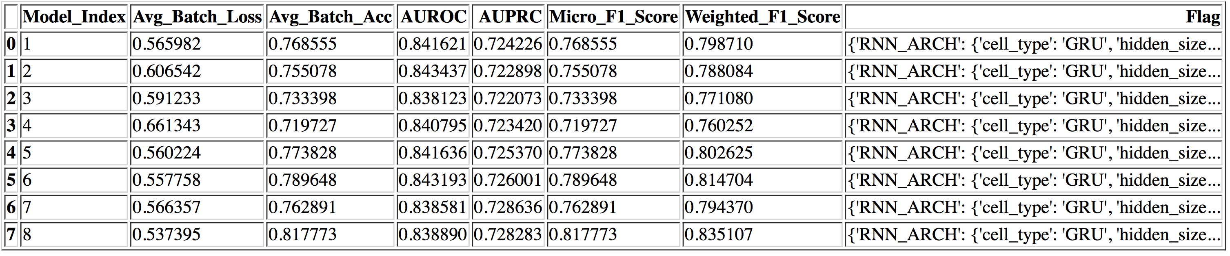
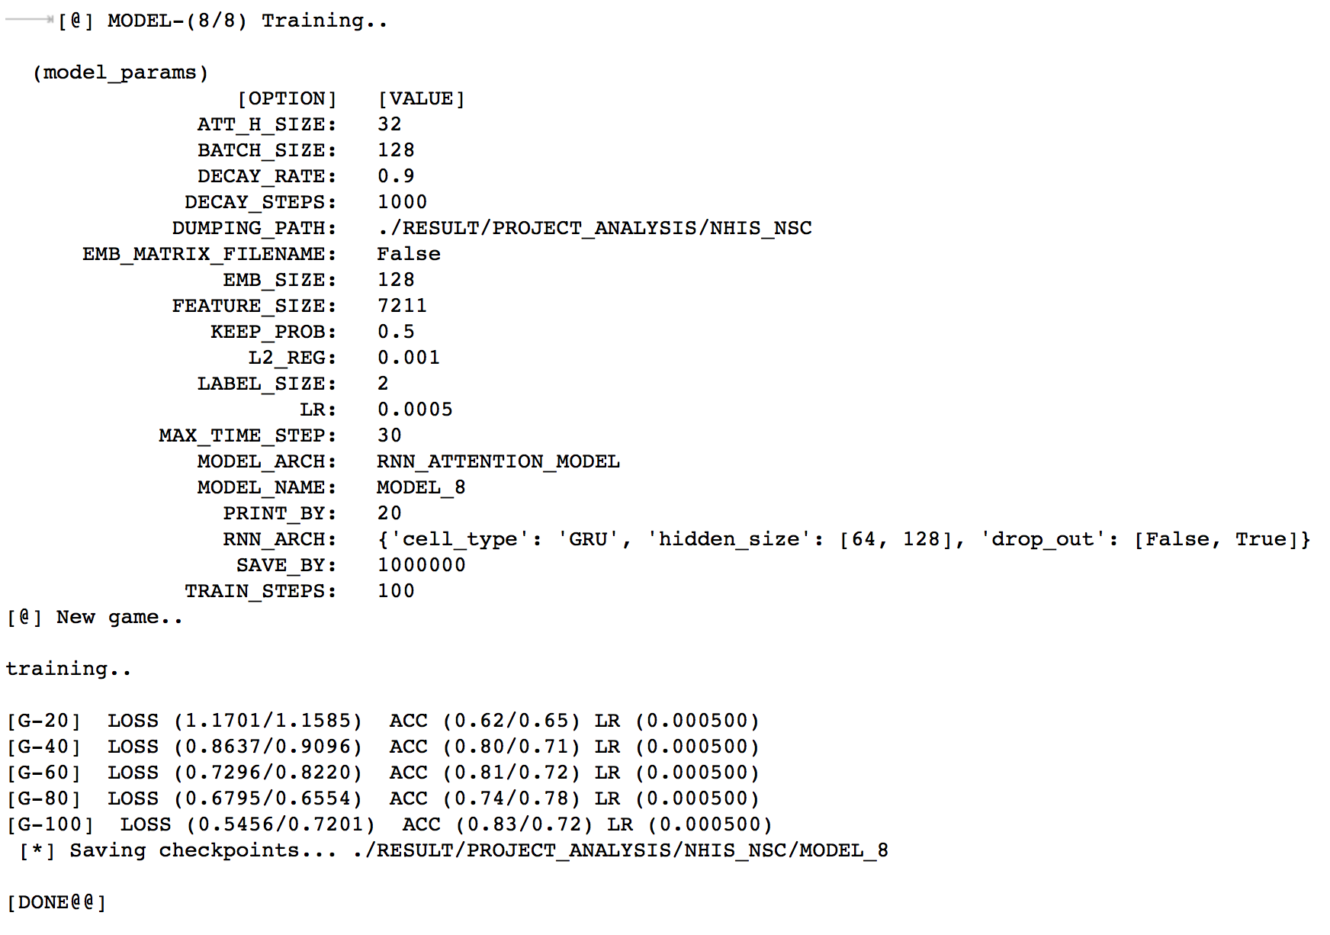
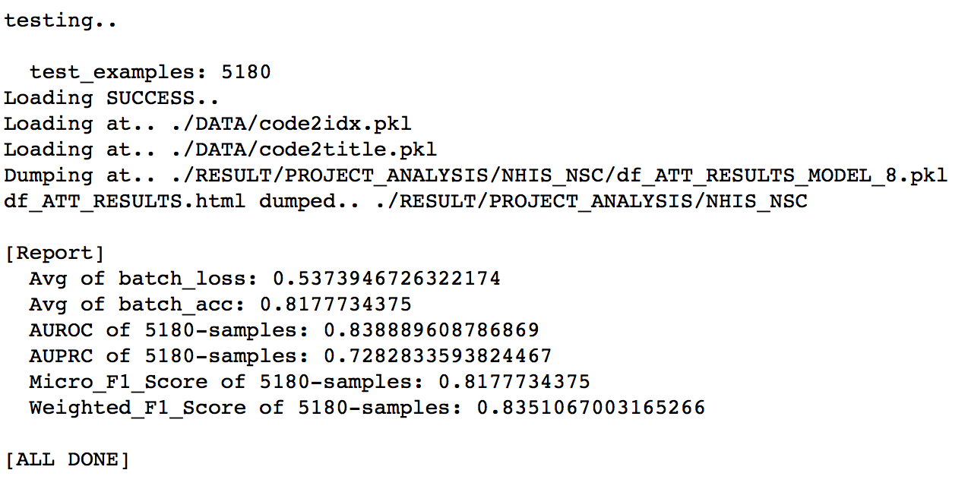
Sequence analyzer; reports
Package Desc.

Slide 17
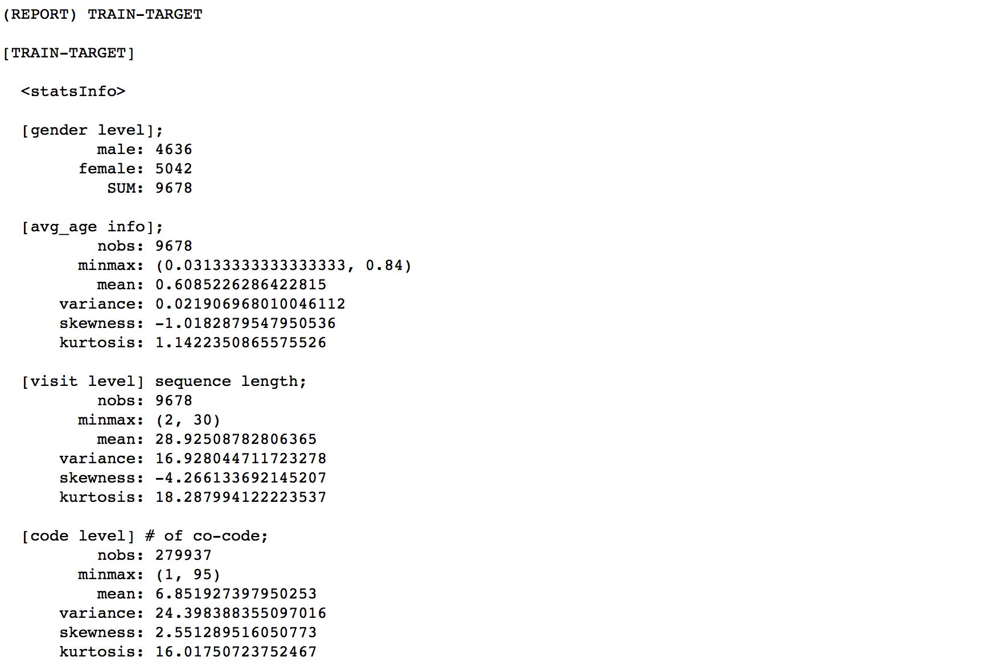
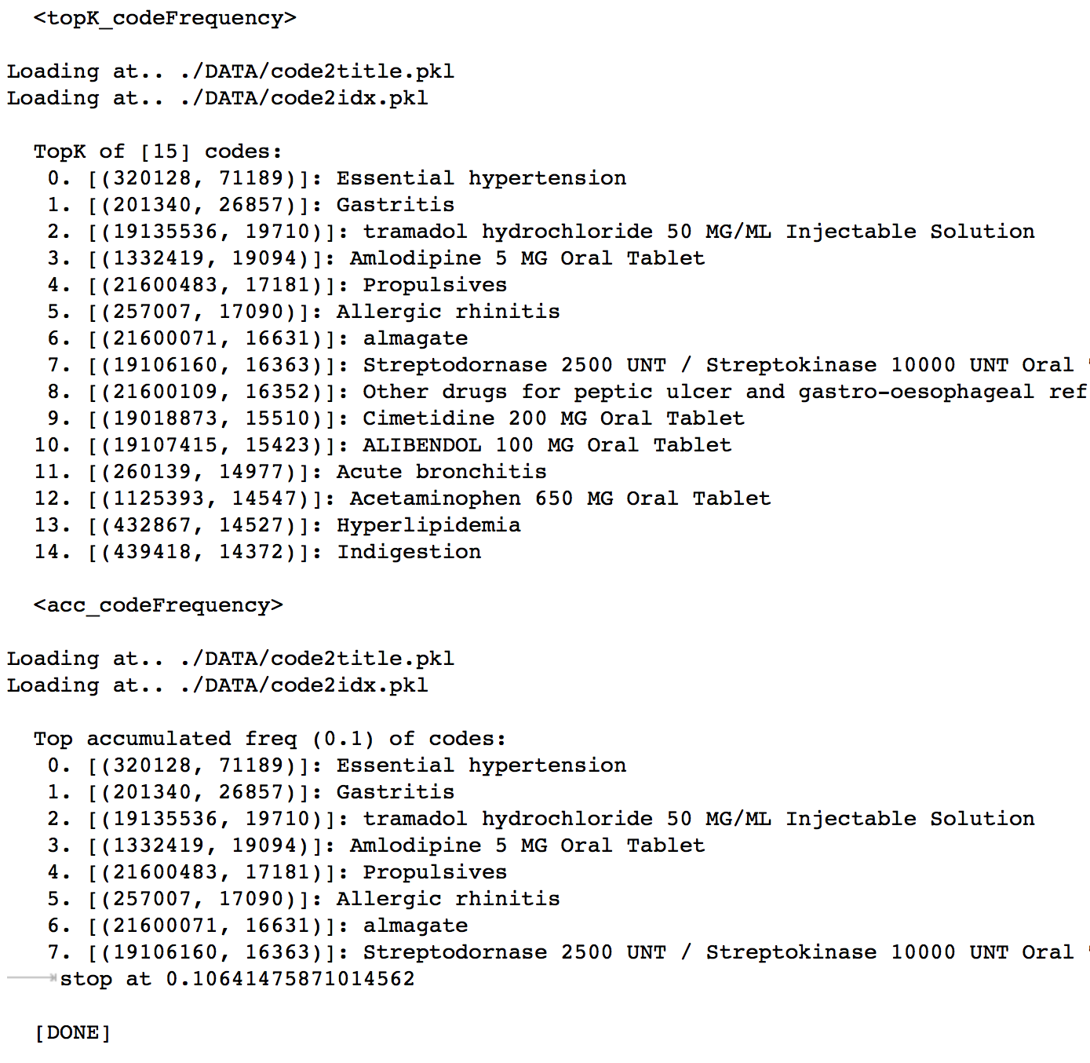
Sequence analyzer; reports
Package Desc.

Slide 18
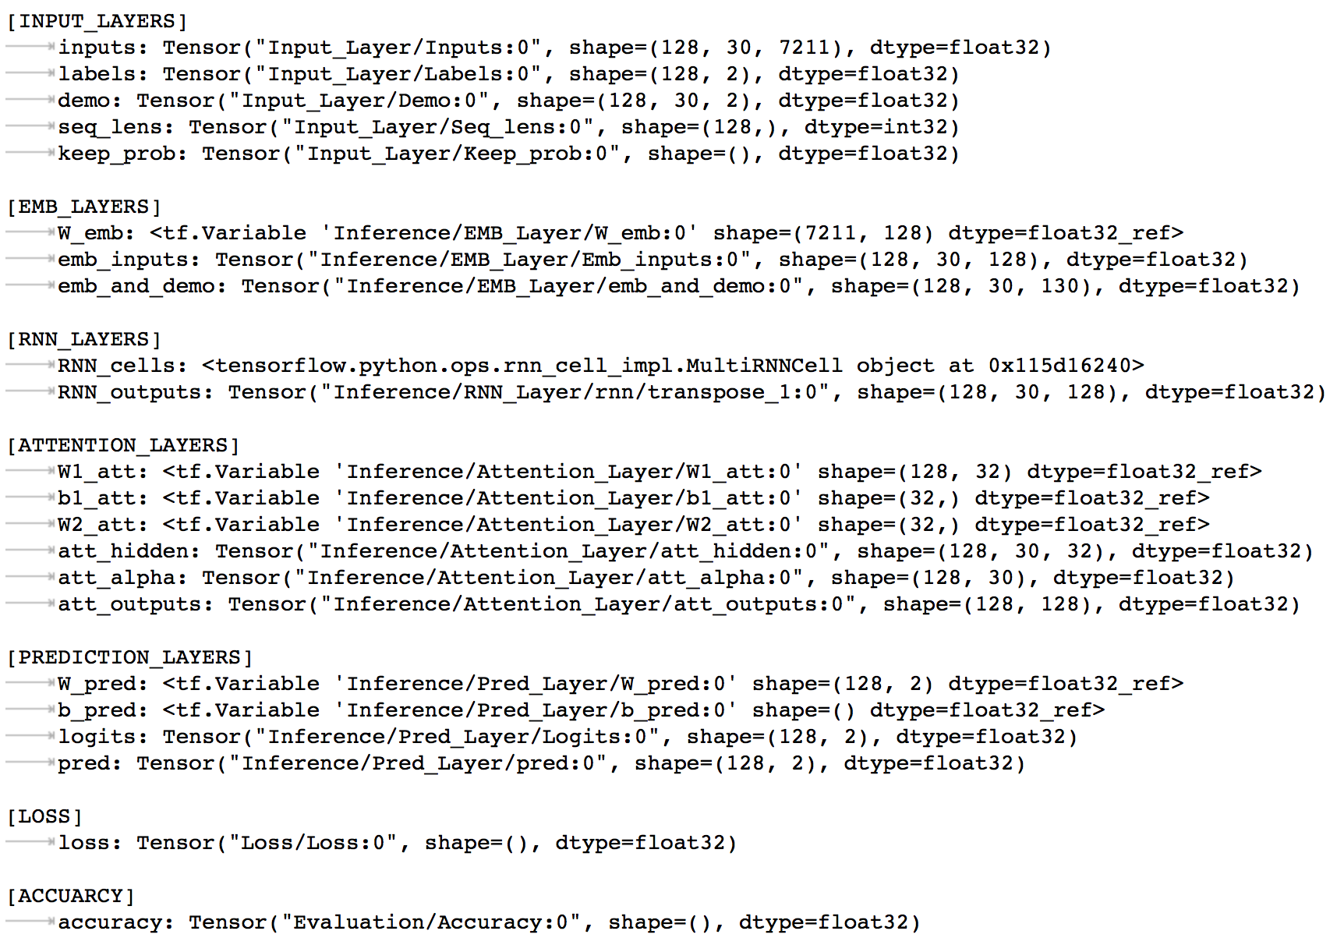
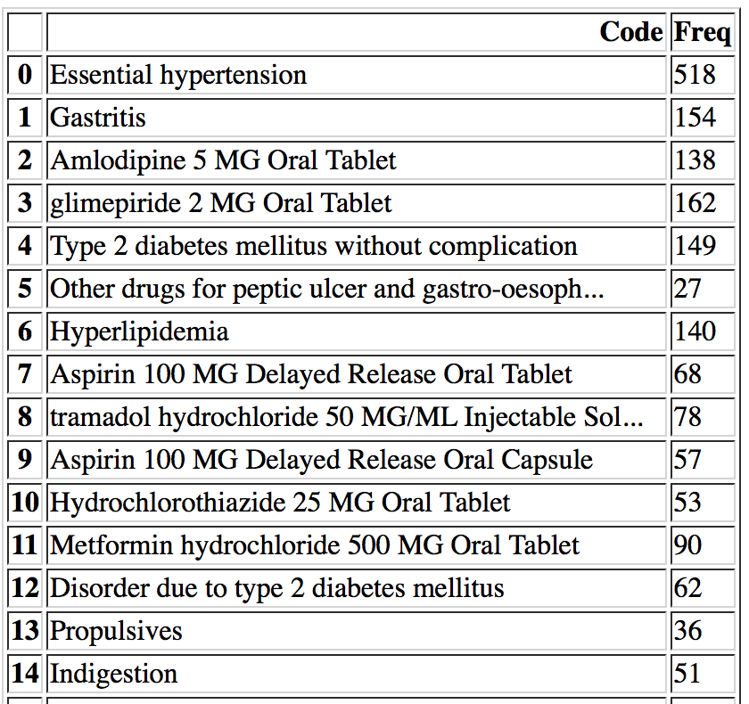
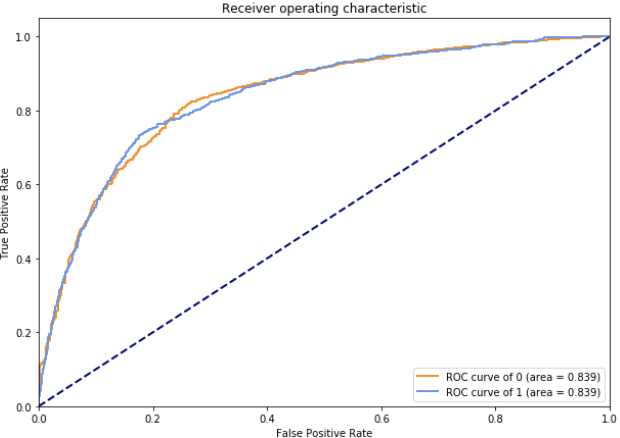
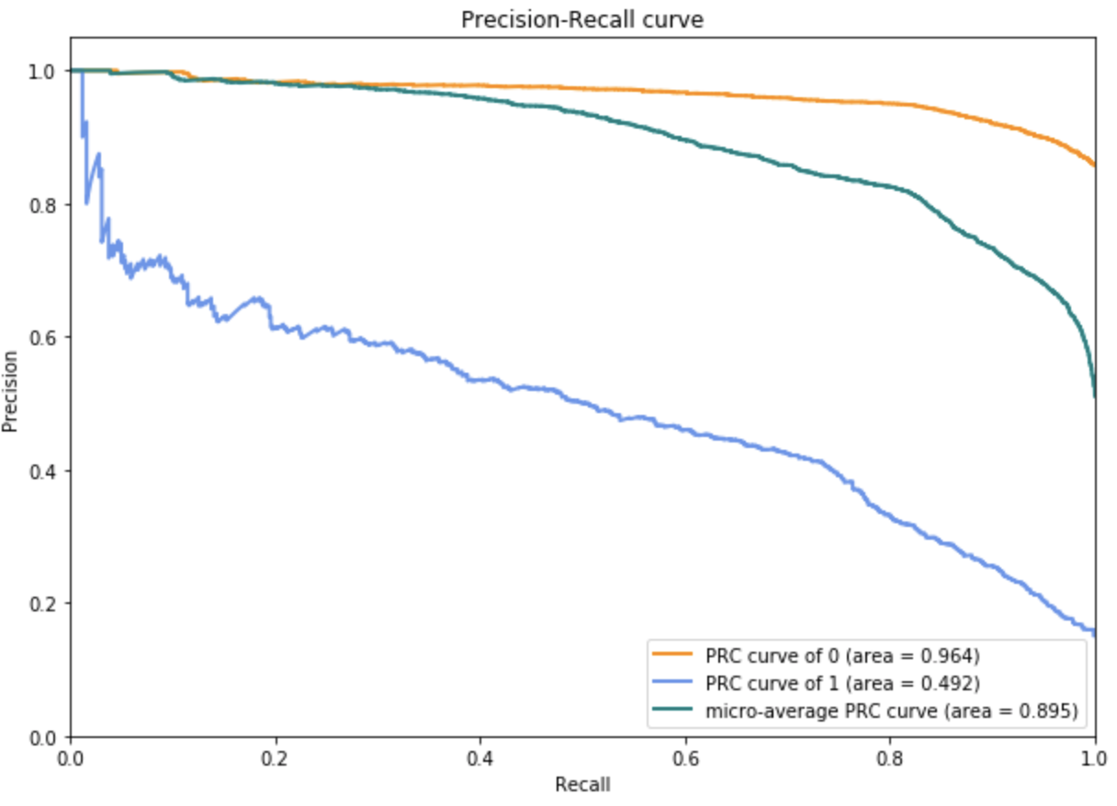
Sequence analyzer; reports
Package Desc.

Slide 19
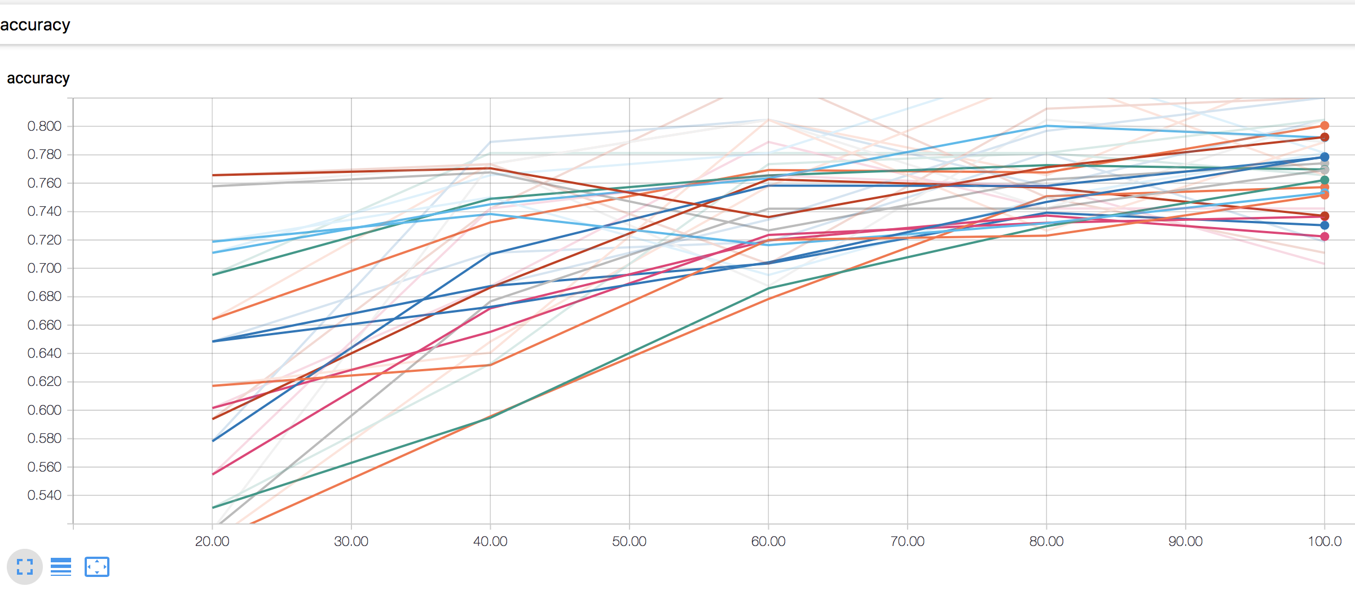
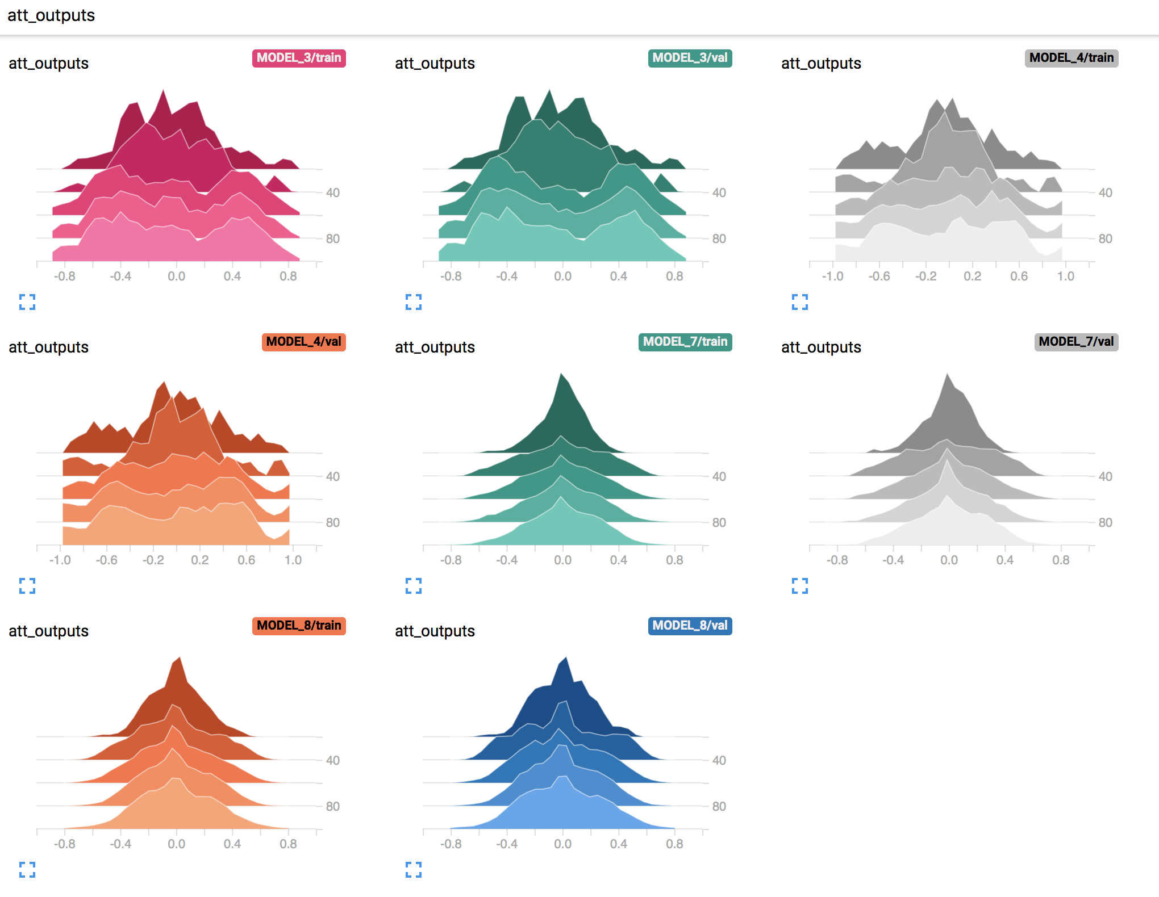
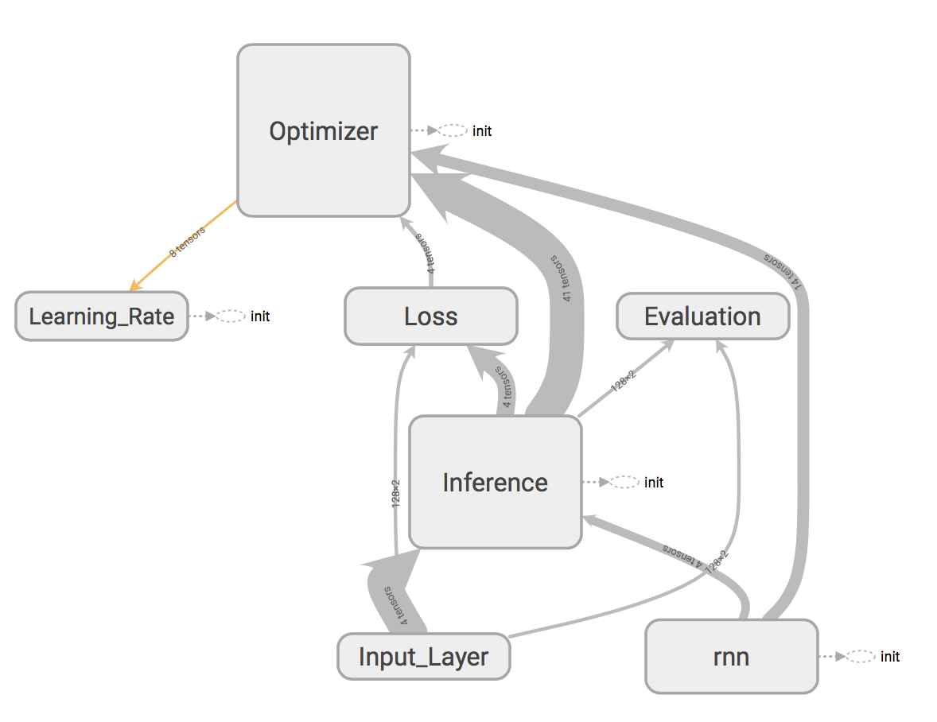
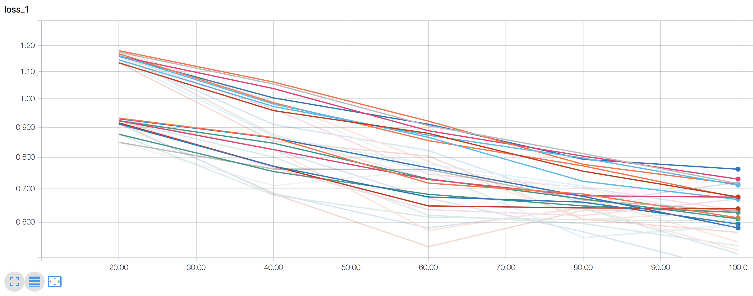
Sequence analyzer; tensorboard
Package Desc.

